Slide 1
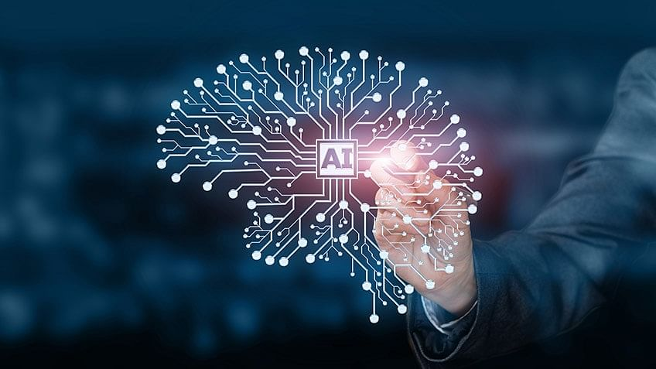
Role of AI By S Satapathy

Slide 2
Definition
Artificial Intelligence is a method of making a computer, a computer-controlled robot, or a software think intelligently like the human mind.
AI is accomplished by studying the patterns of the human brain and by analyzing the cognitive process. The outcome of these studies develops intelligent software and systems.

Slide 3
What is AI
Artificial intelligence (AI) is the ability of a computer or a robot controlled by a computer to do tasks that are usually done by humans because they require human intelligence and discernment.
It simulates the intelligent behaviour in computers
It is the capability of a machine to immitate intelligent human behaviour.
https://youtu.be/uMzUB89uSxU

Slide 4
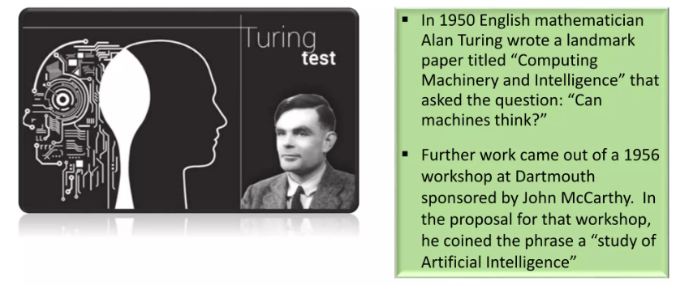
The Early History

Slide 5
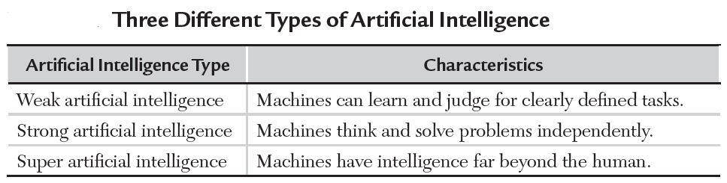
Types of Artificial Intelligence
Weak AI - Focuses on one task and cannot perform beyond its limitations (common in our daily lives)
Strong AI - Can understand and learn any intellectual task that a human being can (researchers are striving to reach strong AI)
Super AI - Surpasses human intelligence and can perform any task better than a human (still a concept)

Slide 6
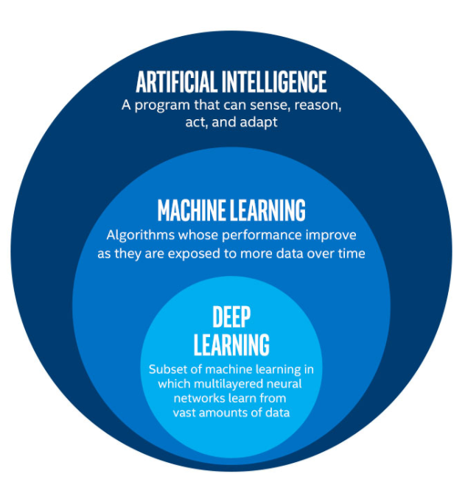
AI, machine learning, and deep learning are interchangeable and easily confusing

Slide 7
Deep learning
Deep learning is a method in artificial intelligence (AI) that teaches computers to process data in a way that is inspired by the human brain. Deep learning models can recognize complex patterns in pictures, text, sounds, and other data to produce accurate insights and predictions.

Slide 8
Artificial intelligence
Artificial intelligence is the simulation of human intelligence processes by machines, especially computer systems. Specific applications of AI include expert systems, natural language processing, speech recognition and machine vision.

Slide 9
Machine Learning
Machine learning is a branch of artificial intelligence (AI) and computer science which focuses on the use of data and algorithms to imitate the way that humans learn, gradually improving its accuracy. IBM has a rich history with machine learning.

Slide 10
Relationship between machine learning and Deep learning and Artificial intelligence
Machine learning and deep learning can be seen as sub-concepts of artificial intelligence. More precisely, the sub-concept of artificial intelligence is machine learning, and the sub-concept .
Machine learning is a sub-concept of artificial intelligence and one of the concrete approaches for realizing artificial intelligence of machine learning is deep learning.
The major aim of ML is to allow the systems to learn by themselves through experience without any kind of human intervention or assistance.

Slide 11
Relationship between machine learning and Deep learning and Artificial intelligence
Deep learning is a sub-concept of machine learning and can be said to be a system that learns through numerous simulations and trial and error.
Deep Learning is basically a sub-part of the broader family of Machine Learning which makes use of Neural Networks(similar to the neurons working in our brain) to mimic human brain-like behavior.
DL algorithms focus on information processing patterns mechanism to possibly identify the patterns just like our human brain does and classifies the information accordingly.
DL works on larger sets of data when compared to ML and the prediction mechanism is self-administered by machines.

Slide 12
Comparison among AI, ML and DL
Artificial Intelligence | Machine Learning | Deep Learning
AI stands for Artificial Intelligence, and is basically the study/process which enables machines to mimic human behaviour through particular algorithm. | ML stands for Machine Learning, and is the study that uses statistical methods enabling machines to improve with experience. | DL stands for Deep Learning, and is the study that makes use of Neural Networks(similar to neurons present in human brain) to imitate functionality just like a human brain.
AI is the broader family consisting of ML and DL as it’s components. | ML is the subset of AI. | DL is the subset of ML.
AI is a computer algorithm which exhibits intelligence through decision making. | ML is an AI algorithm which allows system to learn from data. | DL is a ML algorithm that uses deep(more than one layer) neural networks to analyze data and provide output accordingly.
Source: https://www.geeksforgeeks.org/difference-between-artificial-intelligence-vs-machine-learning-vs-deep-learning/

Slide 13
Comparison among AI, ML and DL Cont…
Artificial Intelligence | Machine Learning | Deep Learning
Search Trees and much complex math is involved in AI. | If you have a clear idea about the logic(math) involved in behind and you can visualize the complex functionalities like K-Mean, Support Vector Machines, etc., then it defines the ML aspect. | If you are clear about the math involved in it but don’t have idea about the features, so you break the complex functionalities into linear/lower dimension features by adding more layers, then it defines the DL aspect.
The aim is to basically increase chances of success and not accuracy. | The aim is to increase accuracy not caring much about the success ratio. | It attains the highest rank in terms of accuracy when it is trained with large amount of data.
Three broad categories/types Of AI are: Artificial Narrow Intelligence (ANI), Artificial General Intelligence (AGI) and Artificial Super Intelligence (ASI) | Three broad categories/types Of ML are: Supervised Learning, Unsupervised Learning and Reinforcement Learning | DL can be considered as neural networks with a large number of parameters layers lying in one of the four fundamental network architectures: Unsupervised Pre-trained Networks, Convolutional Neural Networks, Recurrent Neural Networks and Recursive Neural Networks
Source: https://www.geeksforgeeks.org/difference-between-artificial-intelligence-vs-machine-learning-vs-deep-learning/

Slide 14
Comparison among AI, ML and DL Cont…
Artificial Intelligence | Machine Learning | Deep Learning
The efficiency Of AI is basically the efficiency provided by ML and DL respectively. | Less efficient than DL as it can’t work for longer dimensions or higher amount of data. | More powerful than ML as it can easily work for larger sets of data.
Examples of AI applications include: Google’s AI-Powered Predictions, Ridesharing Apps Like Uber and Lyft, Commercial Flights Use an AI Autopilot, etc. | Examples of ML applications include: Virtual Personal Assistants: Siri, Alexa, Google, etc., Email Spam and Malware Filtering. | Examples of DL applications include: Sentiment based news aggregation, Image analysis and caption generation, etc.
AI refers to the broad field of computer science that focuses on creating intelligent machines that can perform tasks that would normally require human intelligence, such as reasoning, perception, and decision-making. | ML is a subset of AI that focuses on developing algorithms that can learn from data and improve their performance over time without being explicitly programmed. | DL is a subset of ML that focuses on developing deep neural networks that can automatically learn and extract features from data.
Source: https://www.geeksforgeeks.org/difference-between-artificial-intelligence-vs-machine-learning-vs-deep-learning/

Slide 15
Comparison among AI, ML and DL Cont…
Artificial Intelligence | Machine Learning | Deep Learning
AI can be further broken down into various subfields such as robotics, natural language processing, computer vision, expert systems, and more. | ML algorithms can be categorized as supervised, unsupervised, or reinforcement learning. In supervised learning, the algorithm is trained on labeled data, where the desired output is known. In unsupervised learning, the algorithm is trained on unlabeled data, where the desired output is unknown. | DL algorithms are inspired by the structure and function of the human brain, and they are particularly well-suited to tasks such as image and speech recognition.
AI systems can be rule-based, knowledge-based, or data-driven. | In reinforcement learning, the algorithm learns by trial and error, receiving feedback in the form of rewards or punishments. | DL networks consist of multiple layers of interconnected neurons that process data in a hierarchical manner, allowing them to learn increasingly complex representations of the data.
Source: https://www.geeksforgeeks.org/difference-between-artificial-intelligence-vs-machine-learning-vs-deep-learning/

Slide 16
AI in Healthcare
One of the most common applications of AI in the healthcare sector is diagnostics. There, AI is used to: Analyse large data sets of patient health records, so it can identify patterns in patient data that may be indicative of certain diseases or conditions.
Mining medical records. Designing health treatment plans.
Predicting early detection of various life-threatening diseases., doctors and other clinicians can dictate notes hands-free, giving them more face-to-face time with patients.
AI computer-assisted documentation can provide clinicians with suggestions that keep medical records as thorough as possible.

Slide 17
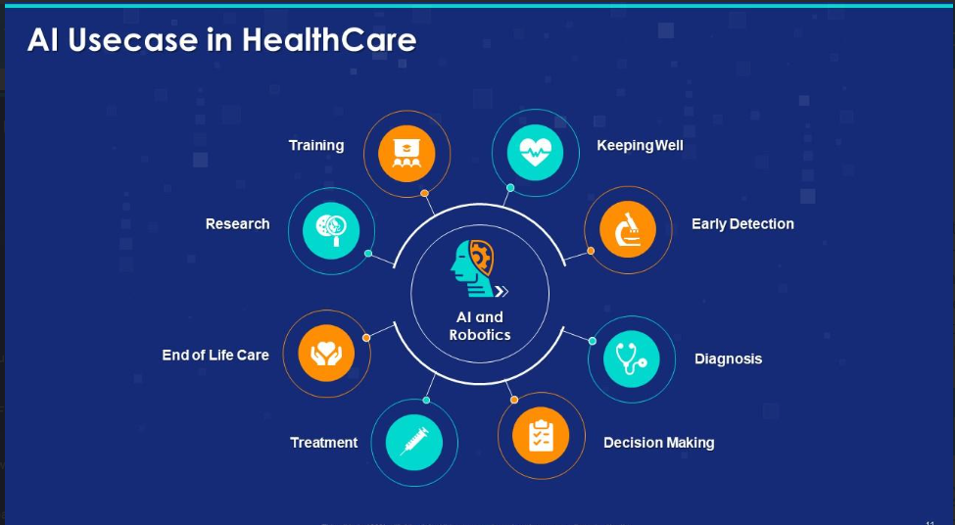
cont..

Slide 18
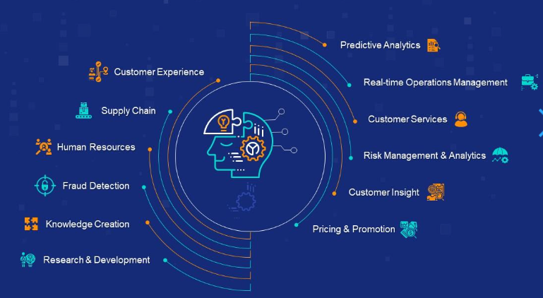
Application of AI
Source: https://www.slideteam.net/introduction-to-artificial-intelligence-powerpoint-presentation-slides.html

Slide 19
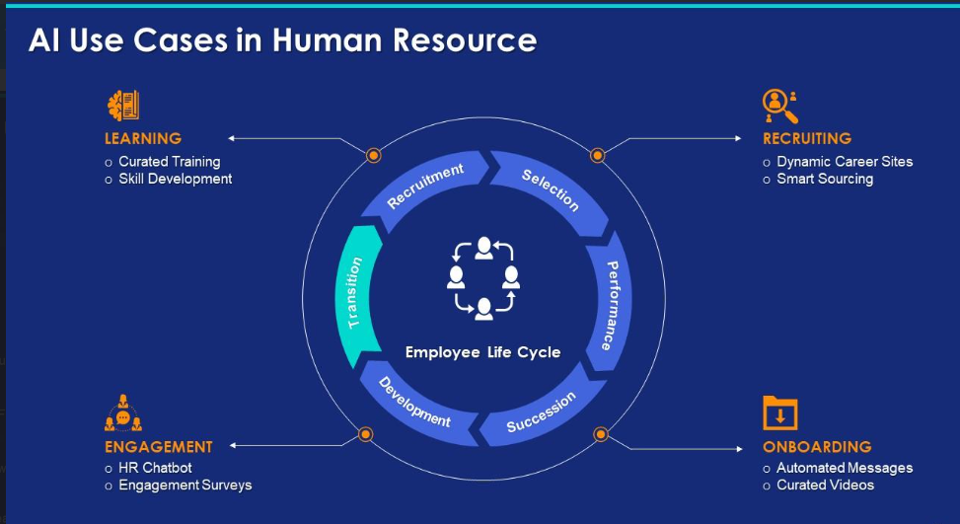
AI in HR
Source: https://www.slideteam.net/introduction-to-artificial-intelligence-powerpoint-presentation-slides.html

Slide 20
AI in HR
AI enables the collection and analysis of data in your HR processes to eliminate biases and guesswork to guarantee you are choosing the right candidate or offering the best compensation and benefits plan.
AI-powered personalized learning and development programs help employees develop their skills, resulting in increased engagement and satisfaction. AI technology also reduces unconscious biases in recruitment, streamlines employee onboarding, and provides predictive analytics for retention.

Slide 21
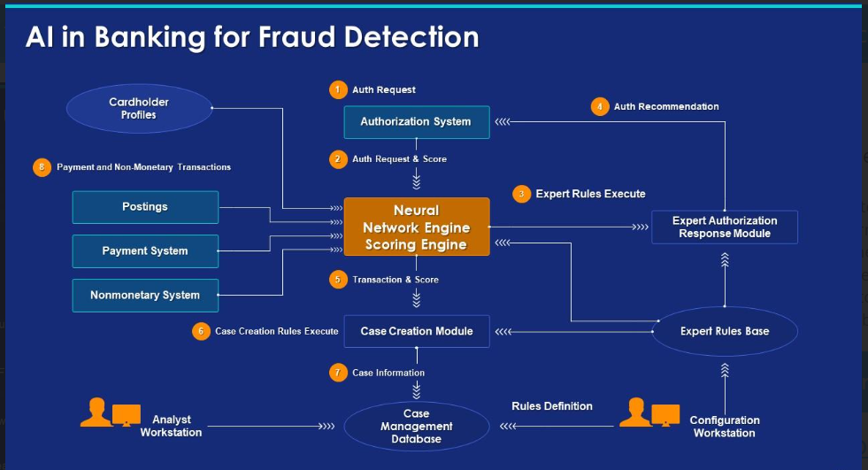
AI in Banking
Source: https://www.slideteam.net/introduction-to-artificial-intelligence-powerpoint-presentation-slides.html

Slide 22
AI in Banking
AI for corporate banking automates tasks, boosts customer services through chatbots, detects fraud, optimizes investment, and predicts market trends. This increases productivity, lowers costs, and provides more individualized services.

Slide 23
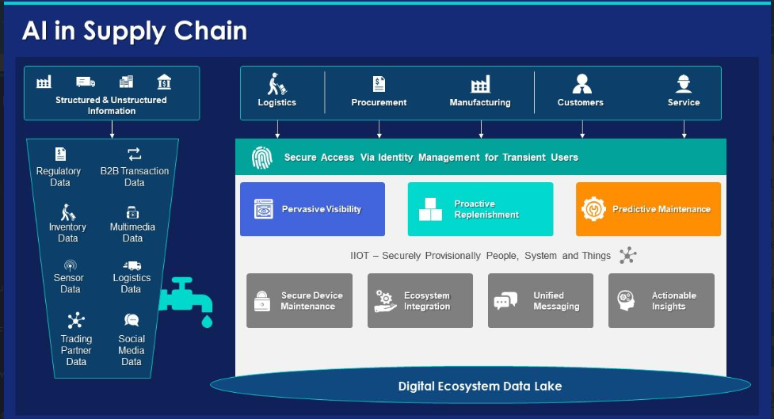
AI in Supply Chain
Source: https://www.slideteam.net/introduction-to-artificial-intelligence-powerpoint-presentation-slides.html

Slide 24
AI in Supply Chain
How AI is used in supply chain?
Top 12 AI Use Cases for Supply Chain Optimization in 2023
Supply chain automation. Modern supply chain automation is not possible without AI. AI gives supply chain automation technologies such as digital workers, warehouse robots, autonomous vehicles, RPA, etc., the ability to perform repetitive, error-prone tasks automatically.

Slide 25
AI Chatbots in Healthcare
Healthcare chatbots can use information about the patient's condition, allergies, and insurance information to schedule appointments faster and better. This includes: Finding a slot at a specialized health facility or lab test center. Rescheduling appointments that are missed or canceled.

Slide 26
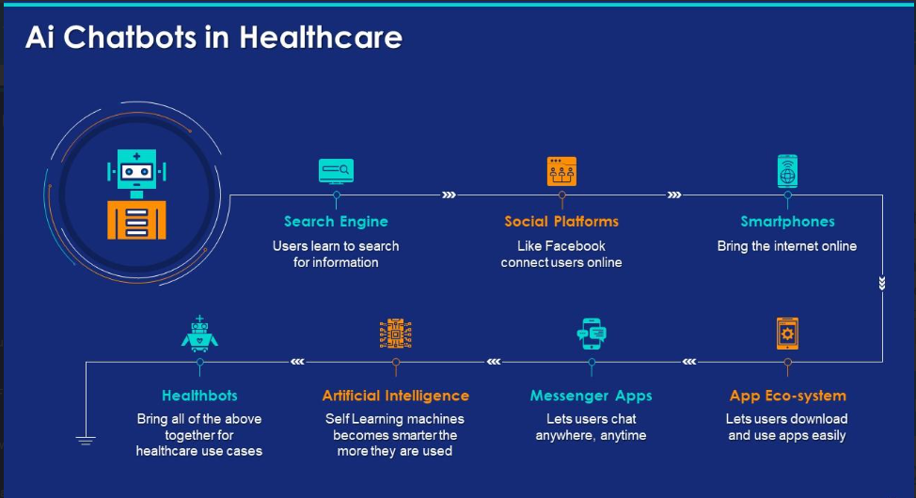
AI Chatbots in Healthcare
Source: https://www.slideteam.net/introduction-to-artificial-intelligence-powerpoint-presentation-slides.html

Slide 27
Why is AI Booming
Increased computing power, big data availability, improved algorithms, industry adoption, and technological convergence has created a favorable environment for the boom of AI in recent years.

Slide 28
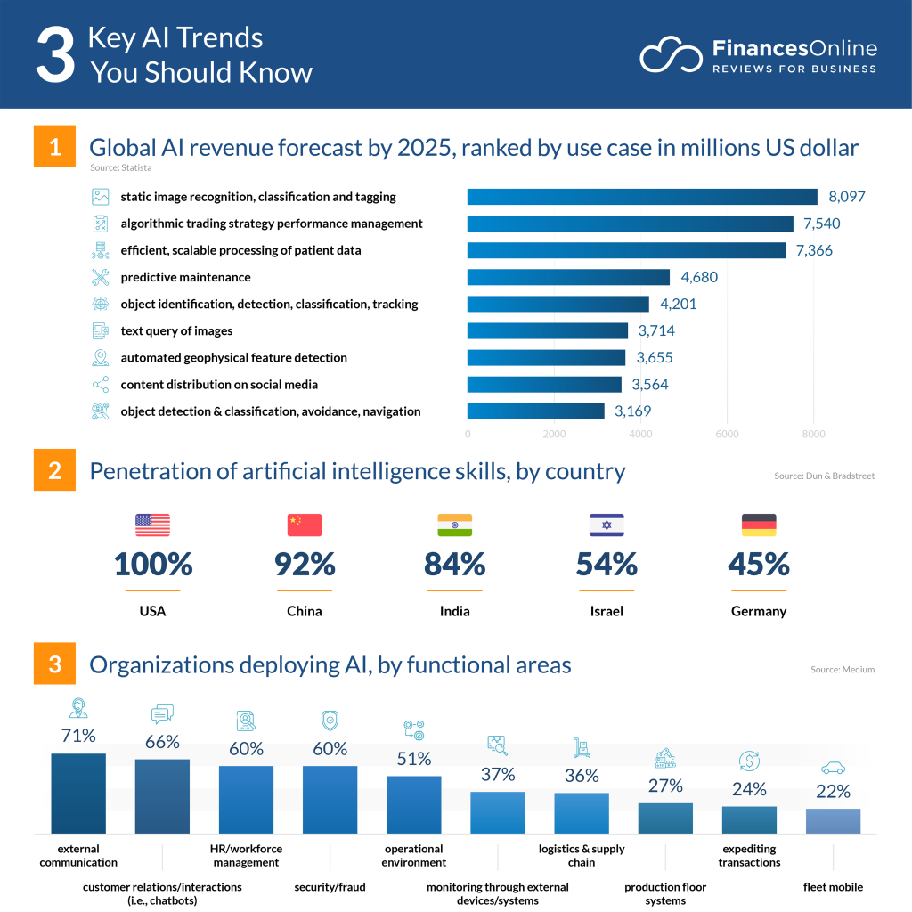
Key AI Trends
Source: https://financesonline.com/ai-trends/

Slide 29
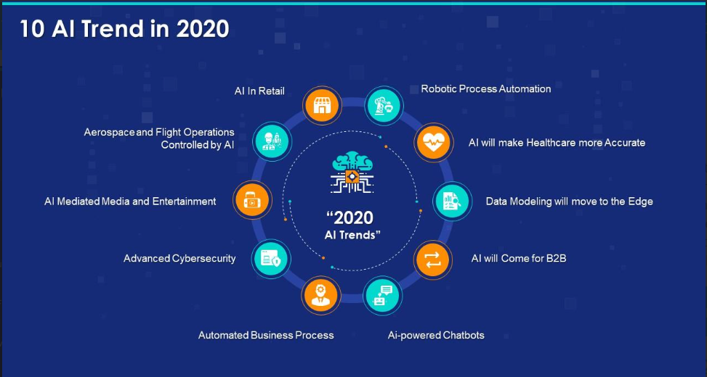
10 AI Trend in 2020
Source: https://www.slideteam.net/introduction-to-artificial-intelligence-powerpoint-presentation-slides.html

Slide 30
Advantages of AI
1. Reduction in Human Error
2. Zero Risks
3. 24x7 Availability
4. Digital Assistance
5. New Inventions
6. Unbiased Decisions
7. Perform Repetitive Jobs
8. Daily Applications
9. AI in Risky Situations
10. Faster Decision-making
11. Pattern Identification
12. Medical Applications
Source: https://www.simplilearn.com/advantages-and-disadvantages-of-artificial-intelligence-article

Slide 31
Disadvantages of AI
1.Substantial dependency on data
2.High Costs
3. No Creativity
4. Unemployment
5. Make Humans Lazy
6. No Ethics
7. Emotionless
8. No Improvement
9.Since artificial intelligence learns and makes judgments by itself, a completely different artificial intelligence may be born that deviates from human development intentions at first.
10.Bias can be planted in AI
Source: https://www.simplilearn.com/advantages-and-disadvantages-of-artificial-intelligence-article
Source: Text book

Slide 32
How Will Artificial Intelligence Affect Jobs 2023-2030
The World Economic Forum has estimated that AI will replace some 85 million jobs by 2025. 65% of retail jobs could be automated by that year, which is largely due to technological advancements, rising costs and wages, tight labor markets, and reduced consumer spending.
Perhaps machines are likely to replace humans in existing simple repetitive tasks due to automation and sensor technology.
If so, there is a high possibility that humans will do more creative and high-thinking tasks that are difficult for artificial intelligence to do, that is, with little existing data.
Source: https://www.nexford.org/insights/how-will-ai-affect-jobs#:~:text=The%20World%20Economic%20Forum%20has,85%20million%20jobs%20by%202025.

Slide 33
Few useful links
https://www.analyticsvidhya.com/blog/2018/05/10-videos-machine-intelligence/
Instructors are encouraged to show few videos available in above link illustrating Amazing Applications of Artificial Intelligence (AI)

Slide 34


